Slide 1
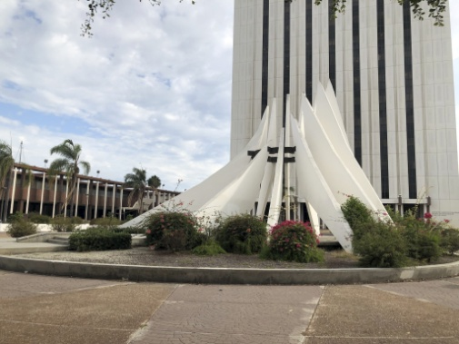
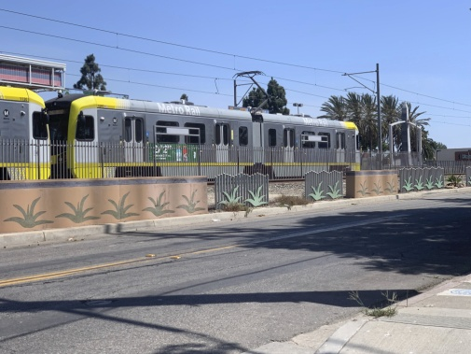
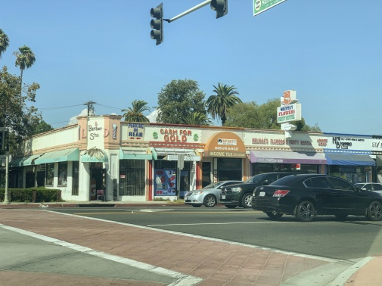
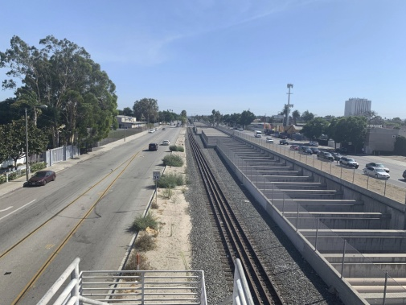
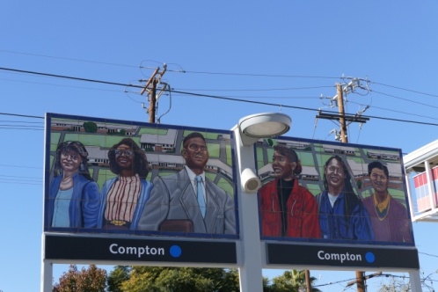
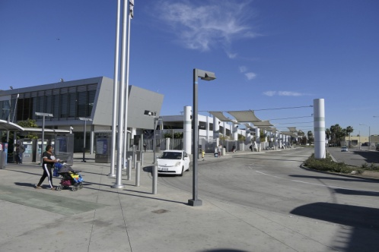
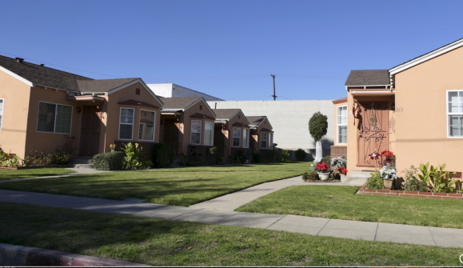
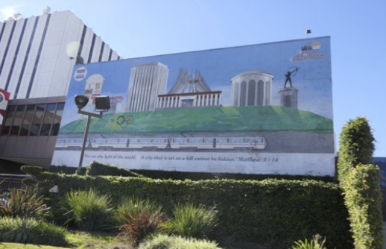
next stop compton
CITY COUNCIL STUDY SESSION
July 28, 2020
The Arroyo Group

Slide 2
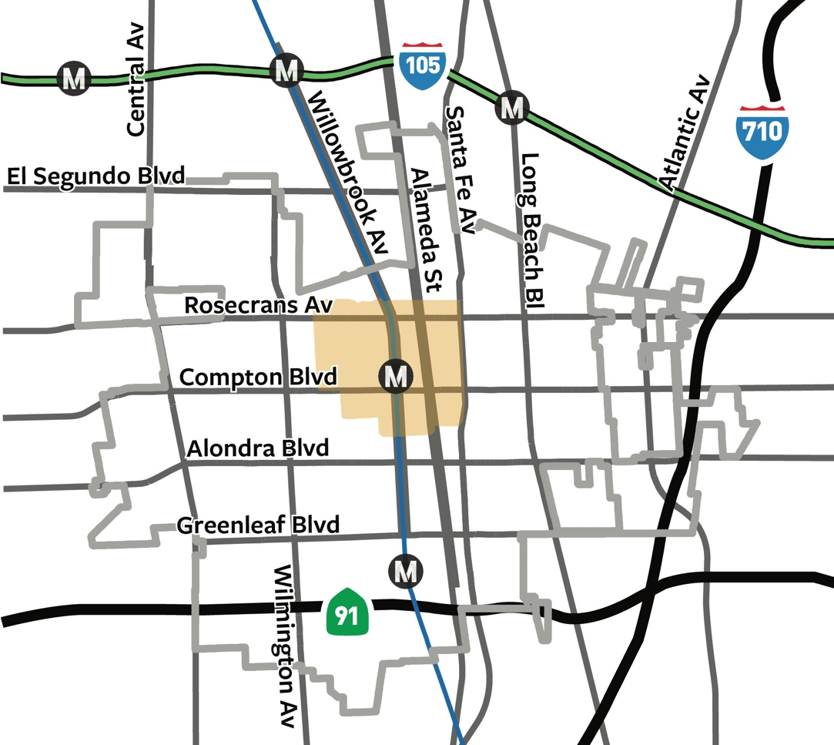
Next Stop Compton will create a new
Compton Station Specific Plan.

Slide 3
Purposes of the Specific Plan
“Building a better downtown”
Promote new development and rehabilitation
Increase transit ridership
Strengthen local identity and unique sense of place
Create employment, career and advancement opportunities
Create a pedestrian- and bike-friendly environment

Slide 4
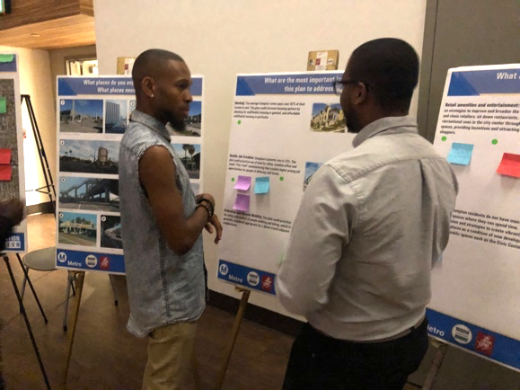
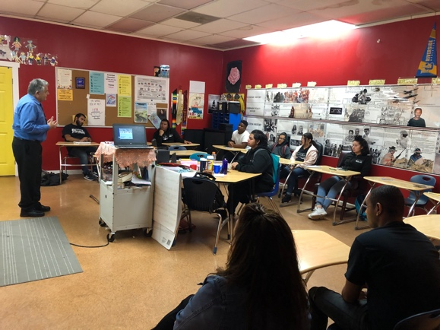
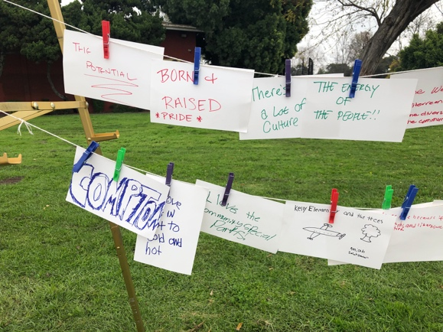
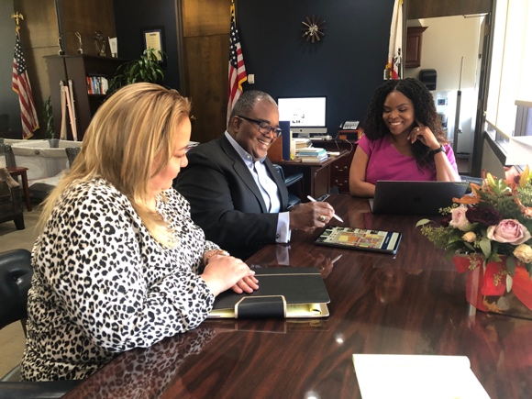
Outreach
Open Mic Night
YouthBuild
Online Survey
Christmas Parade
Stakeholder interviews
Developer interviews
Stakeholders Committee
Planning Commission

Slide 5
Compton Values
Brother’s Keeper: Compton is a family-oriented community where people look out for each other.
Compton Proud: Compton is proud of its unique and historic community.
Hub of Culture: Compton creates culture that spreads worldwide, yet contributes to the city.
Building the Future: Compton invests in educational, artistic, recreational and career opportunities for its youth.

Slide 6
Community Priorities
Maintenance and Security
Housing
Retail Amenities and Entertainment
Community Gardens and Urban Greening
Pedestrian and Bicycle Mobility
Arts and Culture
Quality Job Creation
Ranked by # votes in
surveys and at events

Slide 7
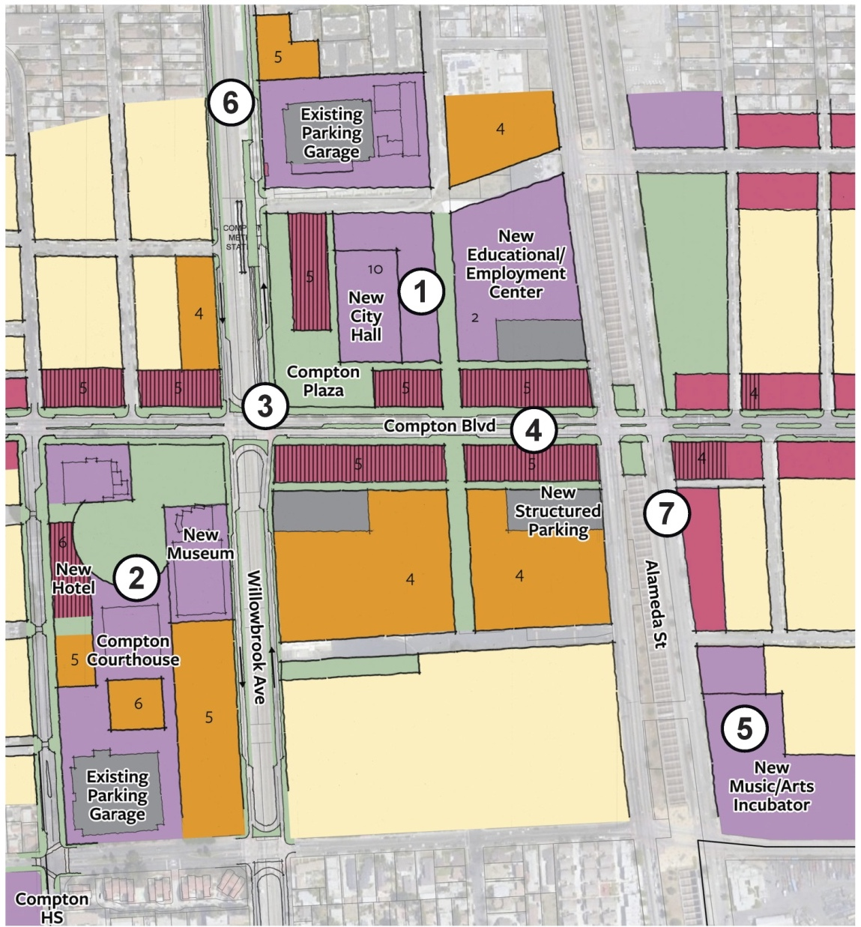
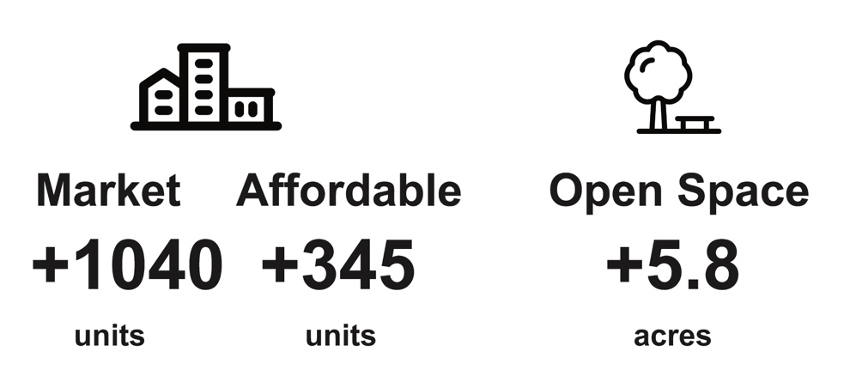
A – Cultural Alternative
Notes:
The stats on the left are not at the same scale as the following slides.

Slide 8
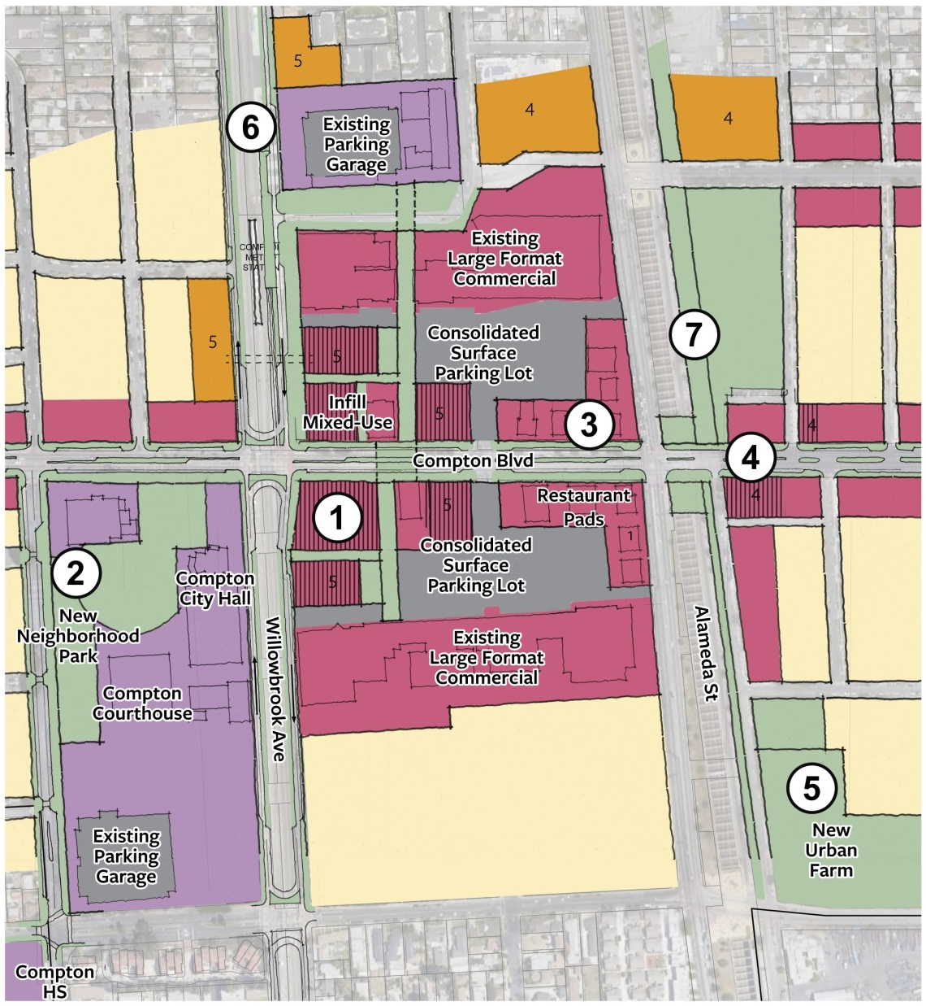
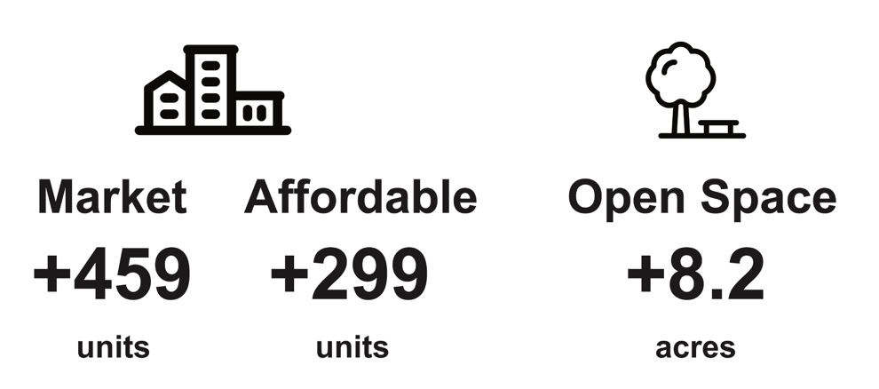
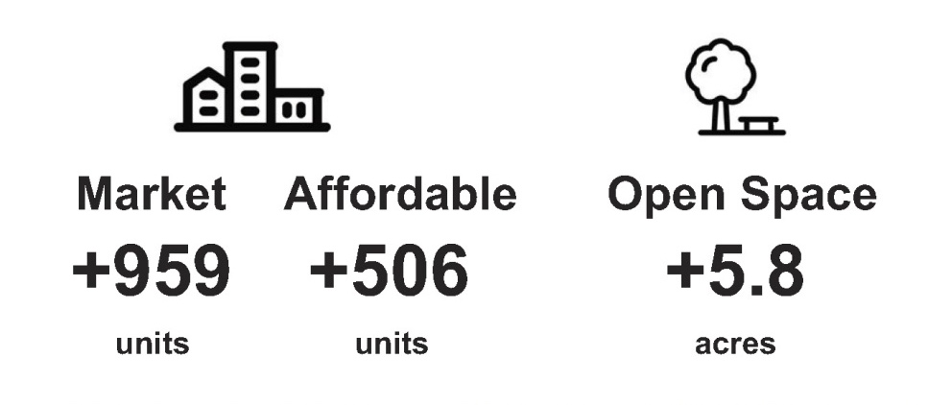
B – Greening Alternative

Slide 9
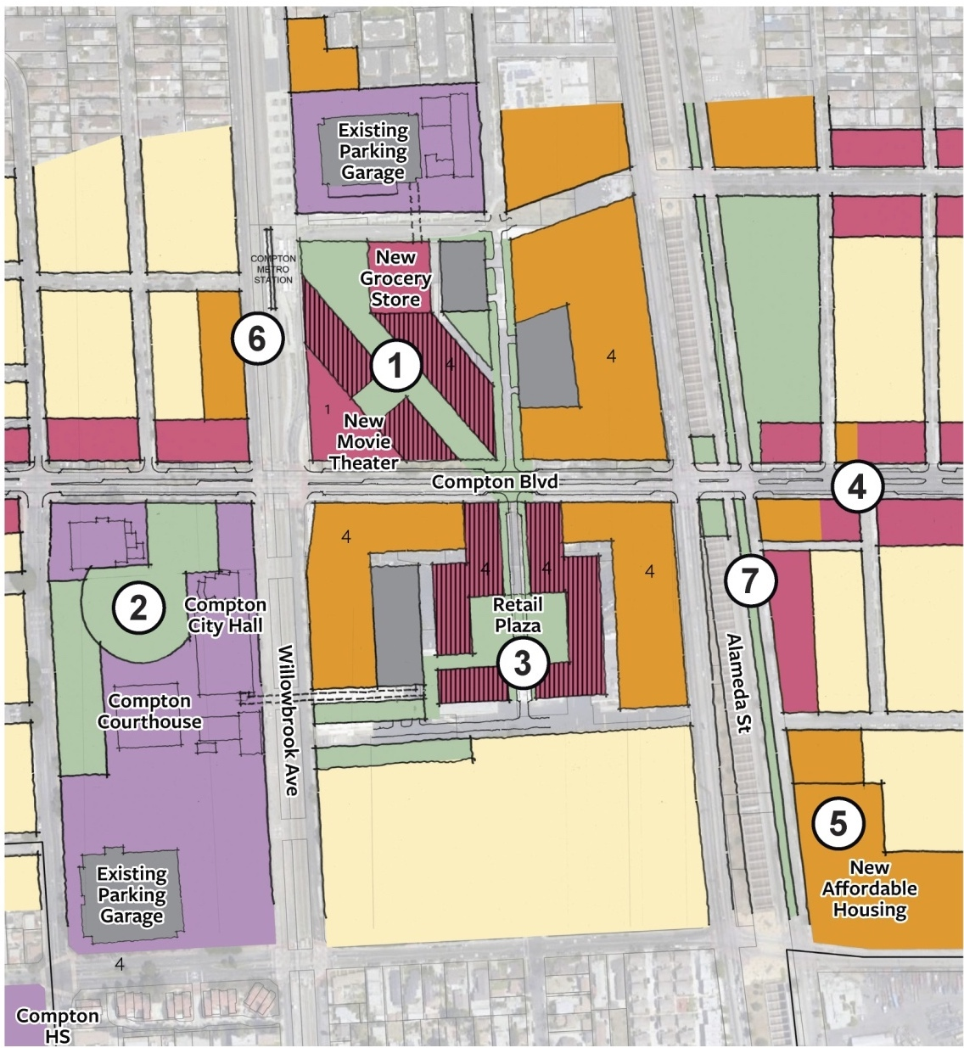
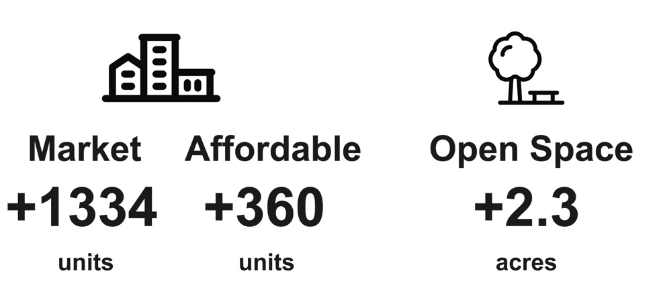
C – Commercial Alternative

Slide 10
Key Implementation Actions
Property-Based Business Improvement District
Affordable housing & incubation spaces on publicly-owned land
Local hire requirements for large projects

Slide 11
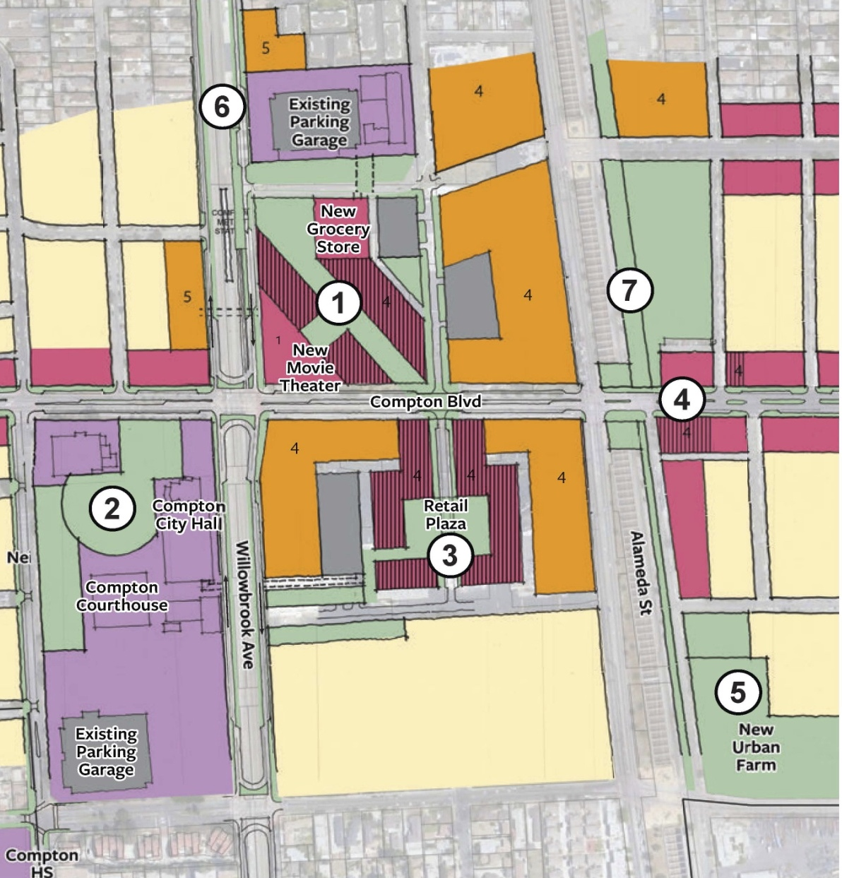
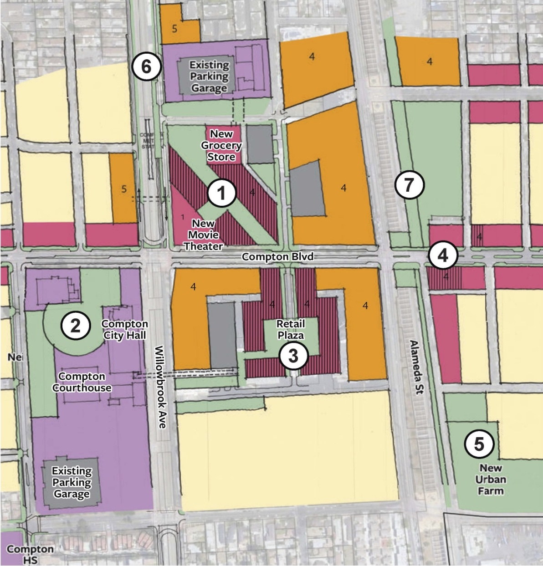
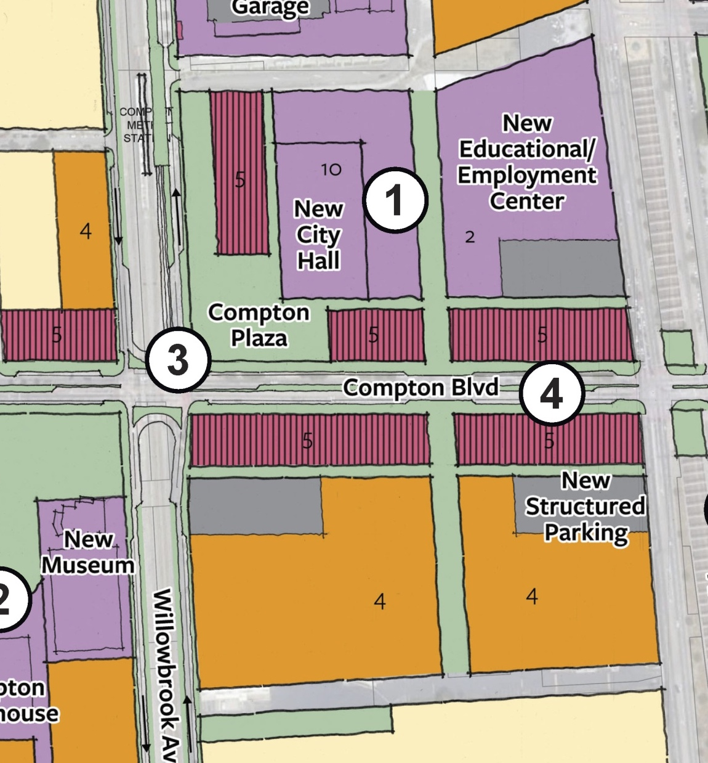
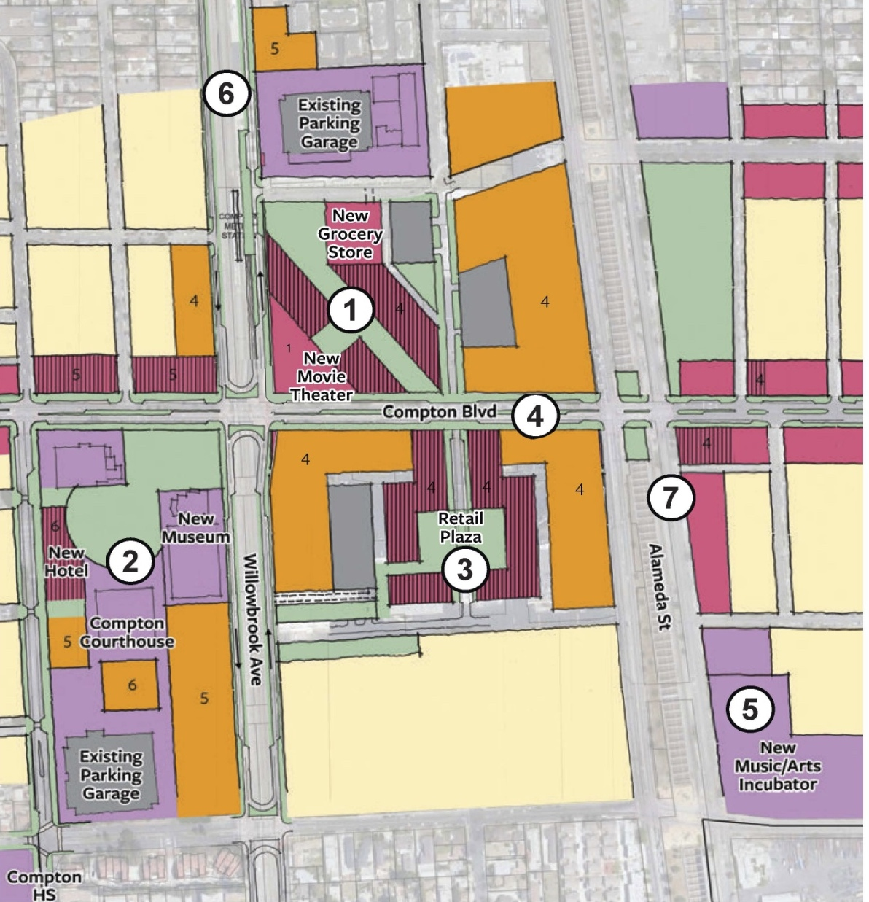
Stakeholders Committee
Preferred Plan
5-8 attendees
Commercial alternative
Civic Center development with park space
Cultural development – music incubator & museum
Compton Bl. narrowing and walk of fame
Notes:
Keep this arrangement tucked away somewhere, but separate out into individual slides. Assume most of people will be viewing this video on phones.

Slide 12
Public & Planning Commission comments
40 responses from public
Commercial alternative
Concern about gentrification
Interest in creating more park space
Unsure about Compton Bl narrowing
Notes:
Keep this arrangement tucked away somewhere, but separate out into individual slides. Assume most of people will be viewing this video on phones.

Slide 13
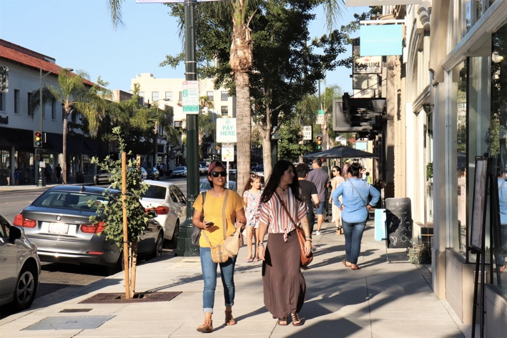
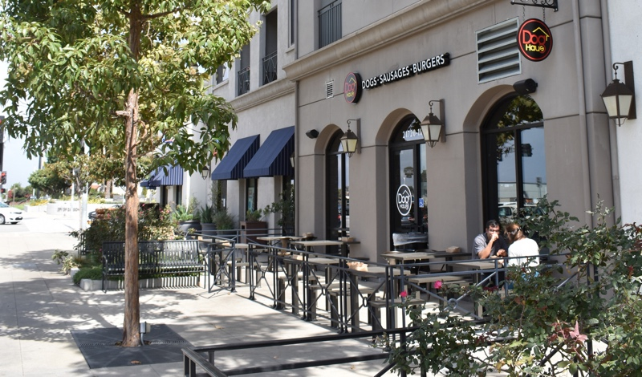
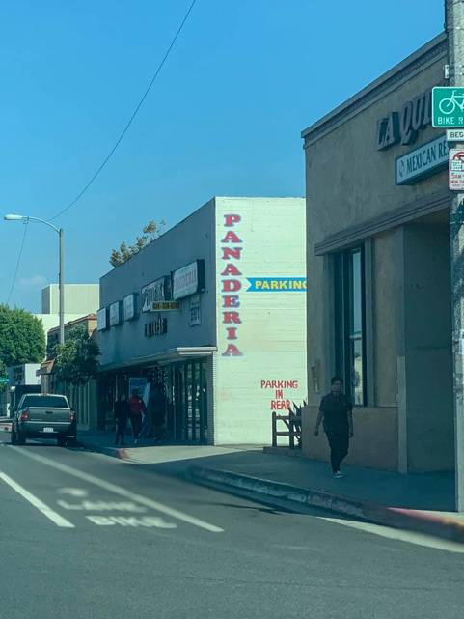
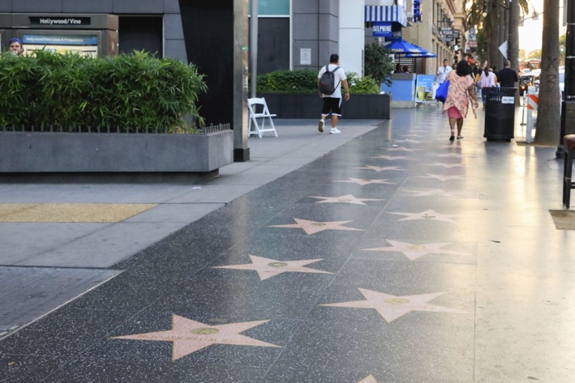
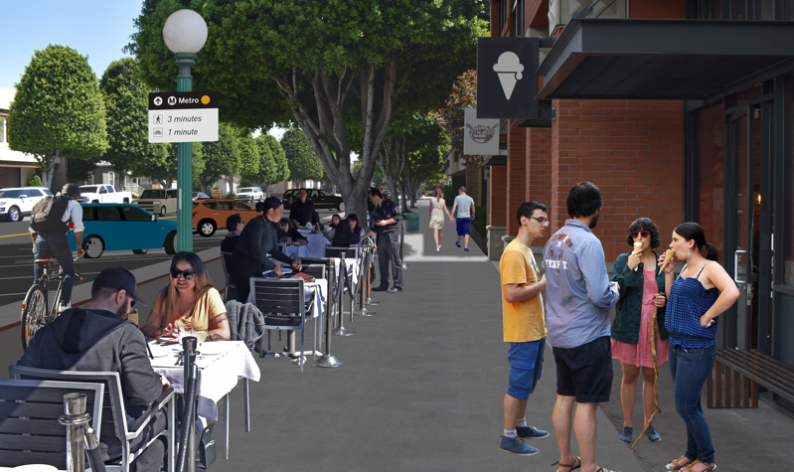
Sidewalk & Public Realm: Compton Blvd.
Other Downtowns (15-25’)
Current (8’)

Slide 14
Compton Bl. Narrowing: Pros & Cons
Village-like feel: Downtown Compton that serves as a destination as opposed to a pass-through area.
- Potential for Class IV protected bicycle lanes (ie, between sidewalk curb and vehicle parking spaces)
- Widened sidewalks
- Shorter and safer crossings for pedestrians
- Reduced vehicle speeds, thus enhancing safety for all users.
- Vehicle delays at the larger arterial intersections would increase
e.g. Compton/Alameda (AM rush hour): +15 seconds
(PM rush hour): +35 seconds

Slide 15
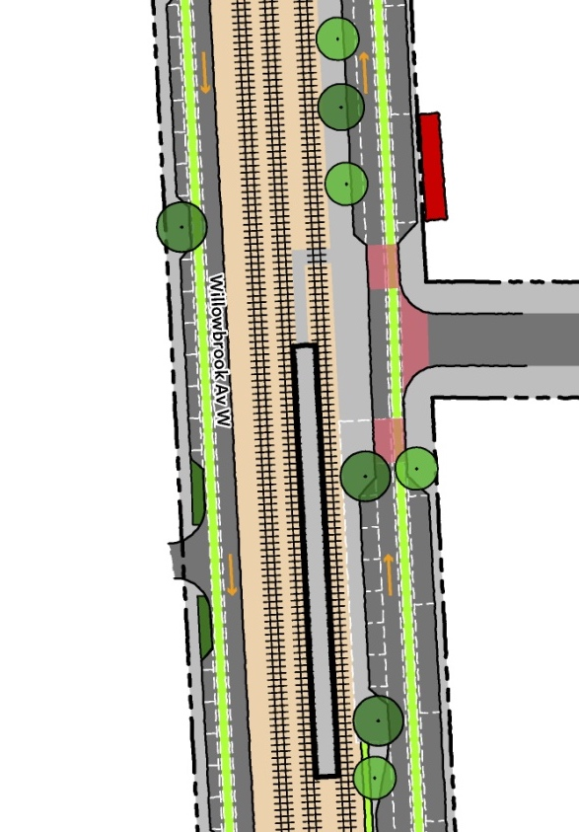
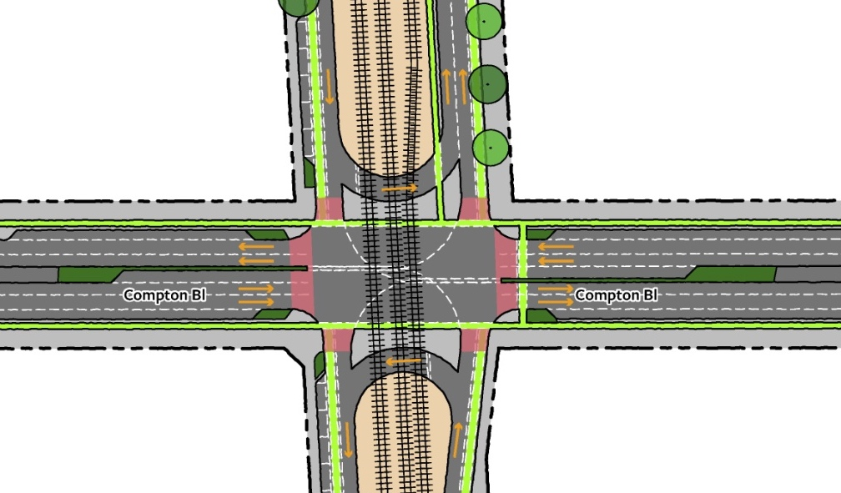
Willowbrook: Alt A (Traditional Couplet)

Slide 16
Willowbrook: Alt A (Traditional Couplet)
Pros:
More intuitive for casual drivers and thus safer for all users
Adds bike lanes on both sides
Allows drivers coming from the west along Compton Blvd to access the station
Cons:
Need to remove and reorient the existing bus station
Need to remove islands and build new gates on all legs of Compton/Willowbrook intersection
Lengthens Sheriff’s Department path leaving station to north
“Texas” U-turn movements require additional signal operations to avoid getting stuck on the tracks

Slide 17
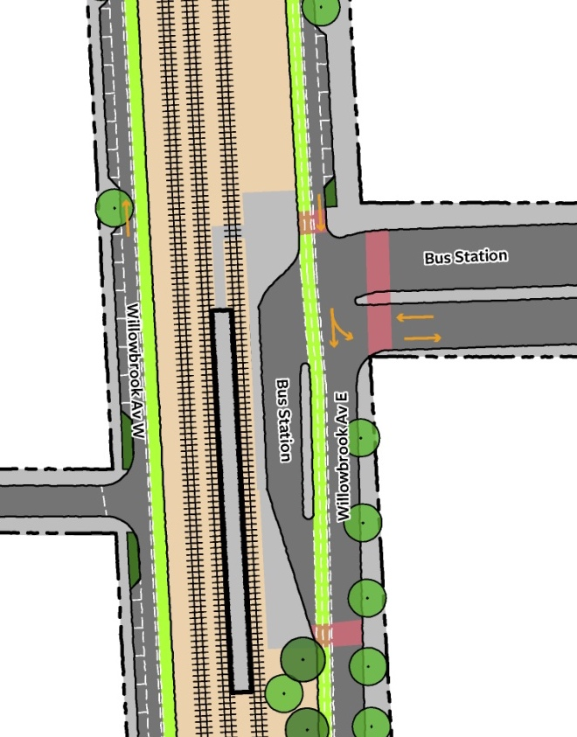
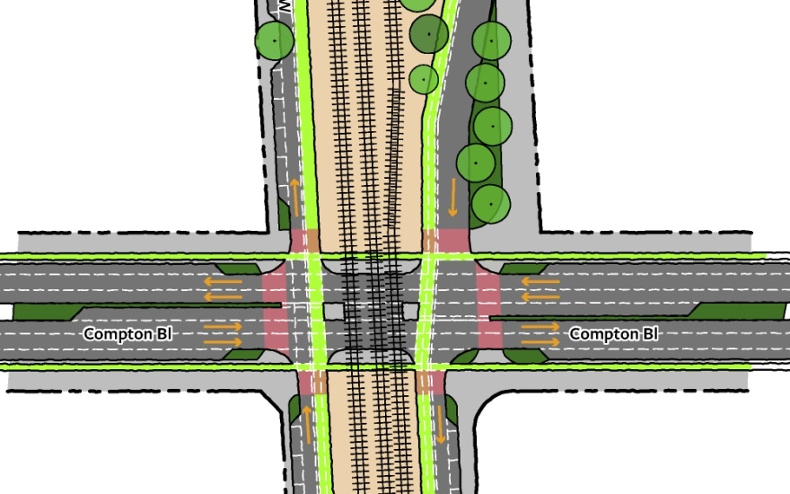
Willowbrook: Alt B (Reverse Couplet)

Slide 18
Willowbrook: Alt B (Reverse Couplet)
Pros:
Adds bike lanes on both sides
Allows for direct downtown access from Rosecrans
Requires only minor modifications to existing bus station
Cons:
Less intuitive, therefore less safety benefit
No new station access for drivers coming from the west

Slide 19
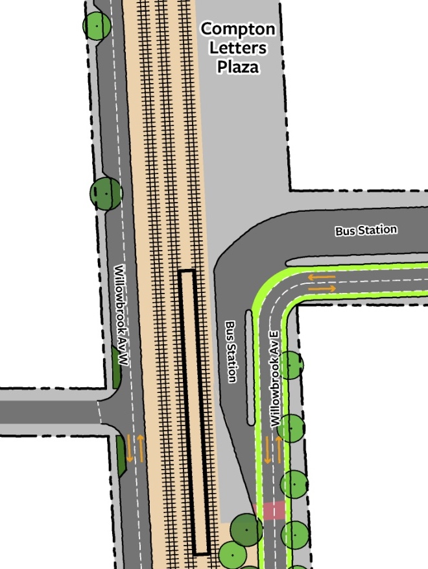
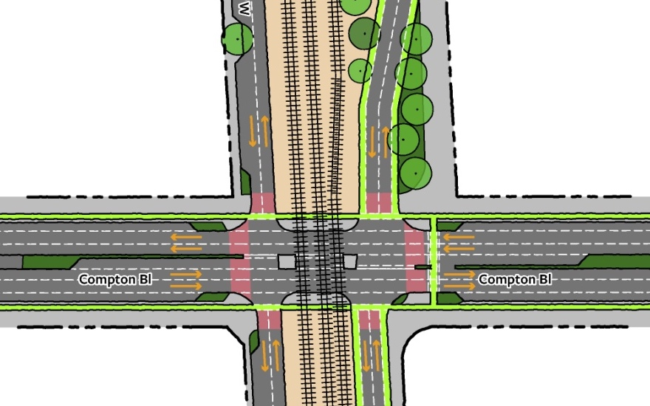
Willowbrook: Alt C (Existing Pattern)

Slide 20
Willowbrook: Alt C (Existing Pattern)
Pros:
Allows easier vehicular access for residents of Willowbrook West
Intersection has decent traffic flow currently because most left turns are prohibited
Keeps COMPTON letters plaza
Cons:
Current configuration is confusing and dangerous for new visitors
No bike lanes on Willowbrook West (east side only)

Slide 21
next stop compton
City council study session
July 28, 2020
The Arroyo Group

